Slide 1
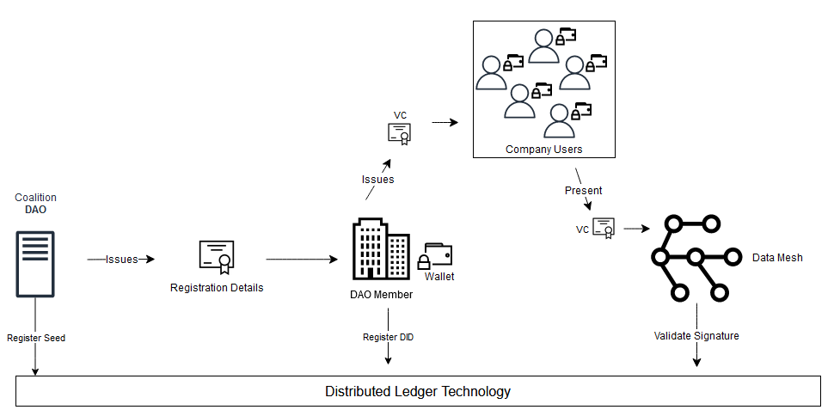
Federated Governance for Decentralized Data-oriented Architectures
Towards a Trust Layer for the Internet
Master Thesis
Andy Aidoo
Intermediate Presentation

Slide 2
Contents
Introduction
Goals
Background
Related Work
Design
Demo
Next Steps
Intermediate Presentation
Andy Aidoo

Slide 3
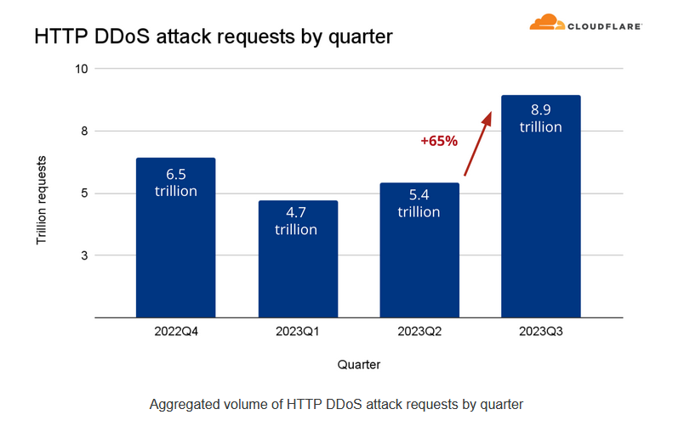
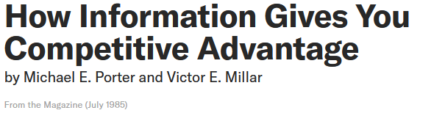
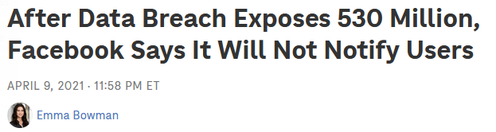
Motivation
Data as competitive advantage
Balance Governance of
Global and Local Policies
Choose Adaptive Data Governance Over One-Size-Fits-All for Greater Flexibility
https://www.gartner.com/en/articles/choose-adaptive-data-governance-over-one-size-fits-all-for-greater-flexibility
Identity Provider Cluster Risk
https://hbr.org/1985/07/how-information-gives-you-competitive-advantage
https://www.npr.org/2021/04/09/986005820/after-data-breach-exposes-530-million-facebook-says-it-will-not-notify-users
DDoS Frequency Increase
https://blog.cloudflare.com/ddos-threat-report-2023-q3/
Intermediate Presentation
Andy Aidoo
Notes:
Data as competitive advantage: https://hbr.org/1985/07/how-information-gives-you-competitive-advantage

Slide 4
Motivation
Data as competitive advantage
Balance Governance of
Global and Local Policies
Choose Adaptive Data Governance Over One-Size-Fits-All for Greater Flexibility
https://www.gartner.com/en/articles/choose-adaptive-data-governance-over-one-size-fits-all-for-greater-flexibility
Identity Provider Cluster Risk
https://hbr.org/1985/07/how-information-gives-you-competitive-advantage
https://www.npr.org/2021/04/09/986005820/after-data-breach-exposes-530-million-facebook-says-it-will-not-notify-users
DDoS Frequency Increase
https://blog.cloudflare.com/ddos-threat-report-2023-q3/
Intermediate Presentation
Andy Aidoo
Notes:
Data as competitive advantage: https://hbr.org/1985/07/how-information-gives-you-competitive-advantage

Slide 5
Motivation
Data as competitive advantage
Balance Governance of
Global and Local Policies
Choose Adaptive Data Governance Over One-Size-Fits-All for Greater Flexibility
https://www.gartner.com/en/articles/choose-adaptive-data-governance-over-one-size-fits-all-for-greater-flexibility
Identity Provider Cluster Risk
https://hbr.org/1985/07/how-information-gives-you-competitive-advantage
https://www.npr.org/2021/04/09/986005820/after-data-breach-exposes-530-million-facebook-says-it-will-not-notify-users
DDoS Frequency Increase
https://blog.cloudflare.com/ddos-threat-report-2023-q3/
Intermediate Presentation
Andy Aidoo
Notes:
Data as competitive advantage: https://hbr.org/1985/07/how-information-gives-you-competitive-advantage

Slide 6
Motivation
Data as competitive advantage
Choose Adaptive Data Governance Over One-Size-Fits-All for Greater Flexibility
Balance Governance of
Global and Local Policies
https://www.gartner.com/en/articles/choose-adaptive-data-governance-over-one-size-fits-all-for-greater-flexibility
Identity Provider Cluster Risk
https://hbr.org/1985/07/how-information-gives-you-competitive-advantage
https://www.npr.org/2021/04/09/986005820/after-data-breach-exposes-530-million-facebook-says-it-will-not-notify-users
DDoS Frequency Increase
https://blog.cloudflare.com/ddos-threat-report-2023-q3/
Intermediate Presentation
Andy Aidoo
Notes:
Data as competitive advantage: https://hbr.org/1985/07/how-information-gives-you-competitive-advantage

Slide 7
Background
Digital Identities
Identity Assurance Level (IAL)
Authentication Assurance Level (AAL)
IAL
“Identity proofing establishes that a subject is who they claim to be.”
“Digital authentication establishes that a subject attempting to access a digital service is in control of one or more valid authenticators with that subject’s digital identity.”
AAL
Decentralized Data Architectures
(theory) Data as Product
(use case) DDoS Attack Fingerprints
NIST Special Publication 800-63-3
Intermediate Presentation
Andy Aidoo

Slide 8
Background
Digital Identities
Identity Assurance Level (IAL)
Authentication Assurance Level (AAL)
IAL
“Digital authentication establishes that a subject attempting to access a digital service is in control of one or more valid authenticators with that subject’s digital identity.”
Emphasis on data quality, i. e. data should provide value, be easy to use and create – depending on the industry it must also conform to regulatory and business strategic policies
“Identity proofing establishes that a subject is who they claim to be.”
AAL
Decentralized Data Architectures
(theory) Data as Product
(use case) DDoS Attack Fingerprints
NIST Special Publication 800-63-3
NIST Special Publication 800-63-3
Marty Cagan. Inspired: How to create tech products customers love. 2017.
Intermediate Presentation
Andy Aidoo

Slide 9
Background
Digital Identities
Authentication Assurance Level (AAL)
IAL
Emphasis on data quality, i. e. data should provide value, be easy to use and create – depending on the industry it must also conform to regulatory and business strategic policies
DDoS Attack Fingerprints:
- are easy to create with ddos_dissector
- contain IP Addresses -> Person Identi- fiable Data (PID)
- may improve Intrusion detection system
“Digital authentication establishes that a subject attempting to access a digital service is in control of one or more valid authenticators with that subject’s digital identity.”
AAL
Decentralized Data Architectures
(theory) Data as Product
(use case) DDoS Attack Fingerprints
NIST Special Publication 800-63-3
Marty Cagan. Inspired: How to create tech products customers love. 2017.
Intermediate Presentation
Andy Aidoo

Slide 10
Background
Digital Identities
Emphasis on data quality, i. e. data should provide value, be easy to use and create – depending on the industry it must also conform to regulatory and business strategic policies
DDoS Attack Fingerprints:
- are easy to create with ddos_dissector
- contain IP Addresses -> Person Identi- fiable Data (PID)
- may improve Intrusion detection system
IAL
AAL
Decentralized Data Architectures
(theory) Data as Product
(use case) DDoS Attack Fingerprints
Marty Cagan. Inspired: How to create tech products customers love. 2017.
Intermediate Presentation
Andy Aidoo

Slide 11
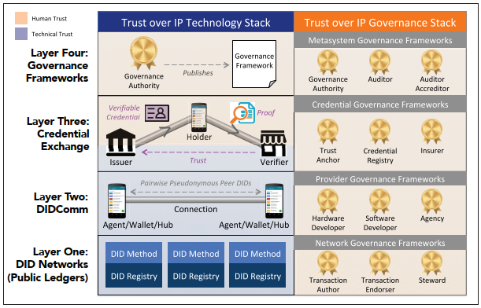
Selected Related Work
“Decentralized Identity: Where Did It Come From and Where Is It Going?”
“Distributed-ledger-based authentication with decentral-
ized identifiers and verifiable credentials”
“Decentralized Data Governance
as Part of a Data Mesh Platform: Concepts and Approaches”
Davie, Matthew, et al. "The trust over ip stack." IEEE Communications Standards Magazine 3.4 (2019): 46-51.
Intermediate Presentation
Andy Aidoo
Notes:
ToIP: → Development of universal decentralized identity framework
- Tech: Decentralized Identifiers (DID) → Decentralized PKI
-- persistent identifier that never needs to change
-- resolvable to DID document that describes attributes like public keys and service endpoints
-- cryptographically verifiable
-- decentralization (DIDs can reside on a
- Tech: Verifiable Data Registry → Blockchain f.i. VON
- Tech: Verifiable Credentials (VC)
- Gov: Registration of new issuers/verifiers → joiners of network
- Gov: Credential Issuance Policy

Slide 12
Design
Goals
High-level Architecture
User-centricity Privacy Preserving
Selective Disclosure
User is data owner
Define Joiner Policies
(Auto) Trusted Join
(Manual) Member Vote
Naming Conventions
Data sensitivity labels
Table and column names
Intermediate Presentation
Andy Aidoo
Notes:
- develop a governance framework to facilitate information exchange in a cross-company data mesh

Slide 13





Process: Issue and Verify Credentials
Verifier
L3
2
1. Issue Verifiable Credentials (VC)
L2
2. Present VC
1
3
3. Verify Signature
Issuer
Proofer
L1
Intermediate Presentation
Andy Aidoo

Slide 14
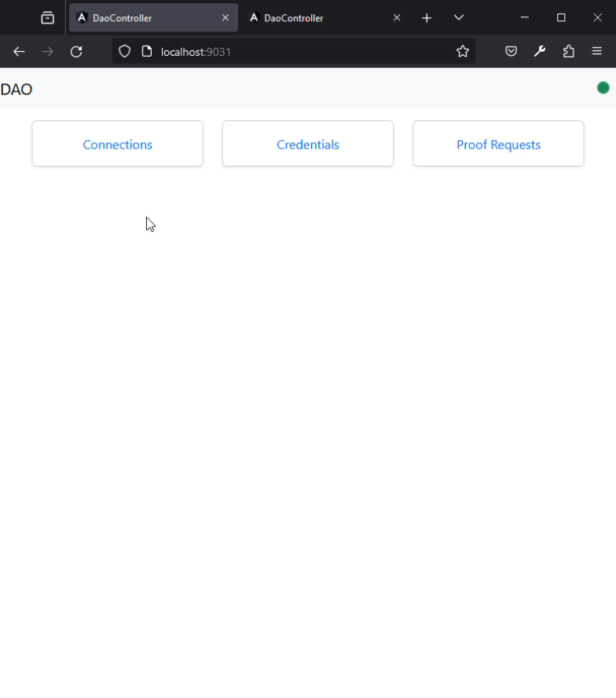
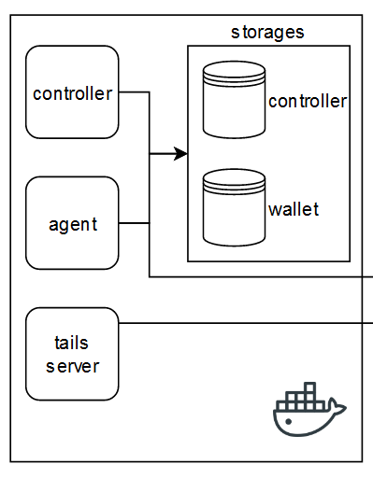
Demo (1/7)
Issuer
#1.1 Create Connection Invitation
+ specify connection alias
+ publish invitation
Intermediate Presentation
Andy Aidoo

Slide 15
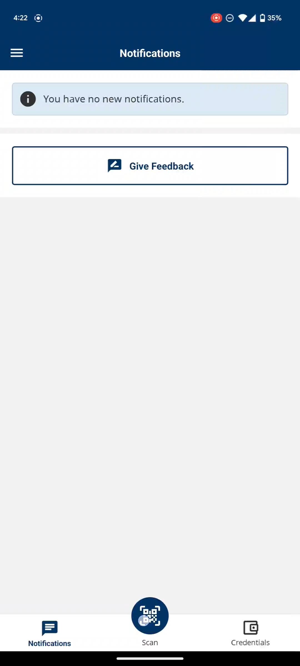

Demo (2/7)
Proofer
#1.2 Scan QR Code to Accept Invitation
Mobile Wallet App
Prototype: BC Wallet
Intermediate Presentation
Andy Aidoo

Slide 16
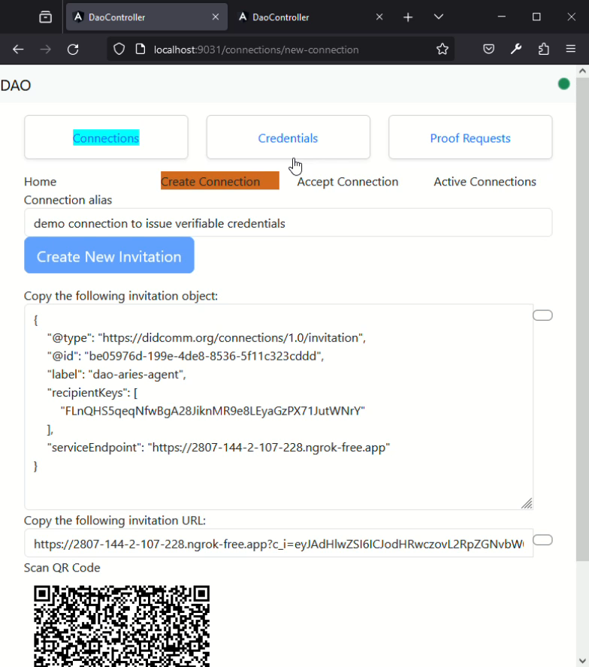
Demo (3/7)
Issuer
#1.3 Issue Verifiable Credentials
+ select connection
+ select credential schema
+ fill form
+ submit form
Intermediate Presentation
Andy Aidoo

Slide 17
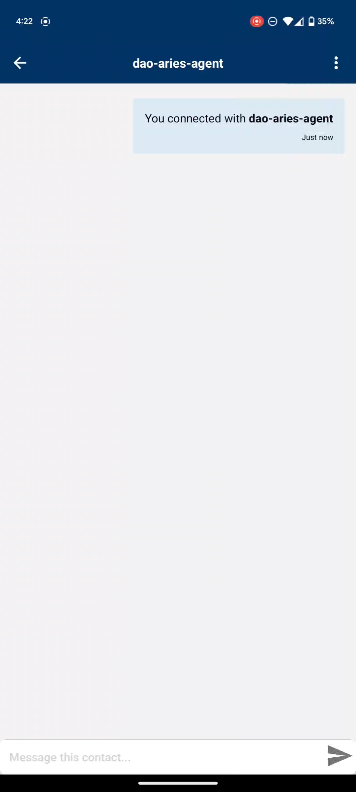
Demo (4/7)
Proofer
#1.4 Receive VC Offer
Mobile Wallet App
Prototype: BC Wallet
#1.5 Accept or decline VCs
Intermediate Presentation
Andy Aidoo

Slide 18
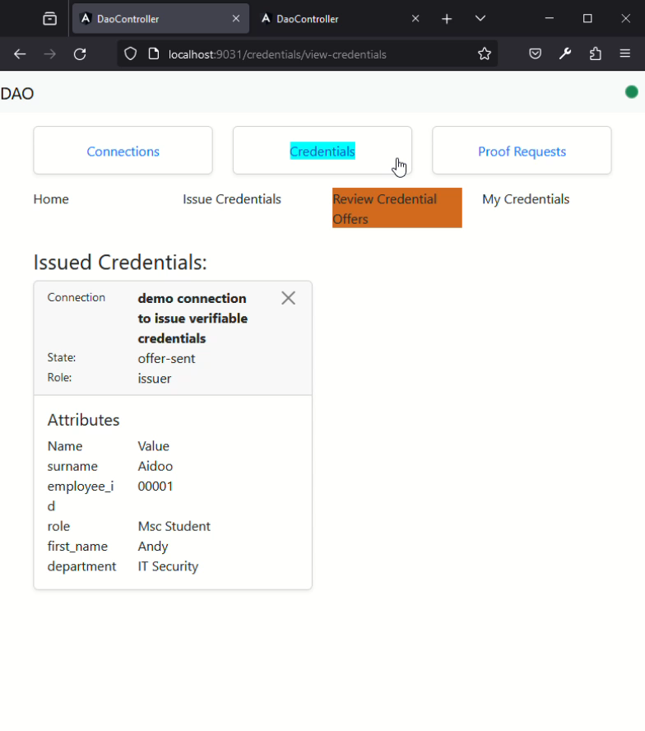
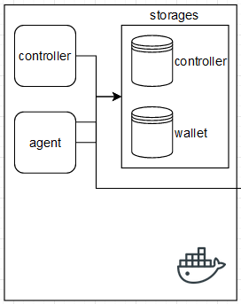
Demo (5/7)
#2.1 Create Proof Request
+ select connection
+ select relevant attributes
+ request proof
Verifier

Slide 19
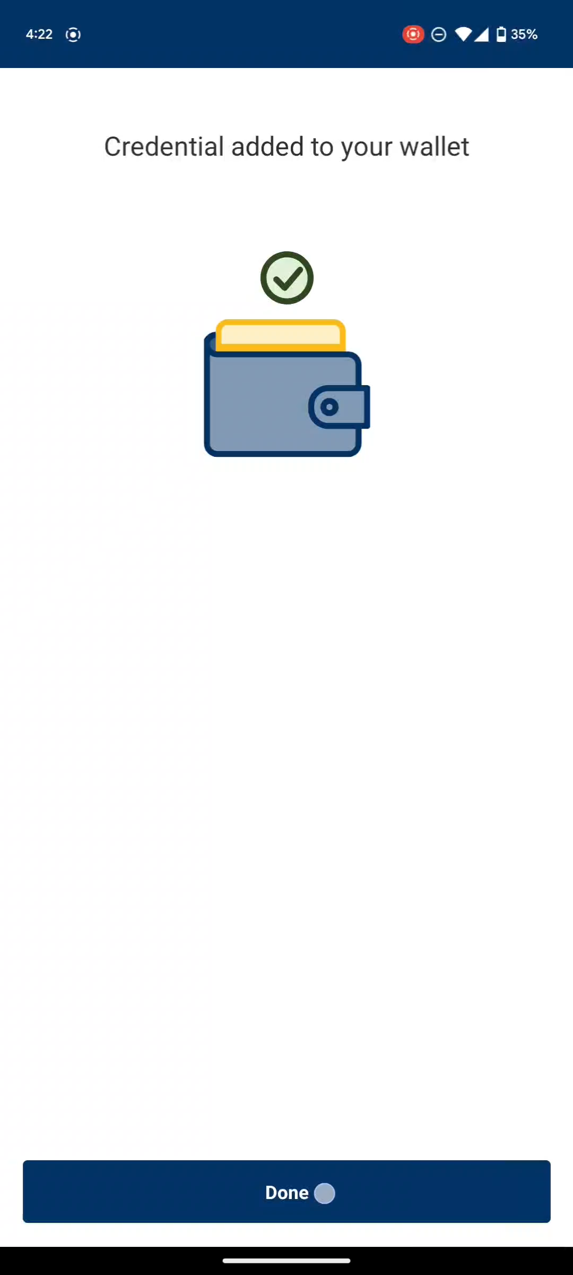
Demo (6/7)
Proofer
#2.2 Review Proof Request
Mobile Wallet App
Prototype: BC Wallet
#2.3 Accept or decline Proof Request
Intermediate Presentation
Andy Aidoo

Slide 20
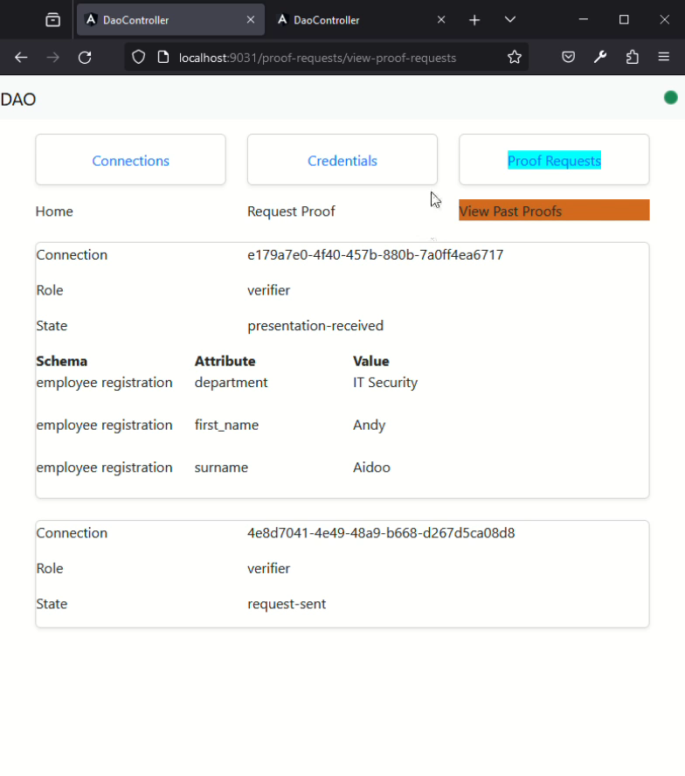

Demo (7/7)
#3 Validate Proof Request
+ select connection
+ check issuer signature on ledger
+ verify integrity
Use Case Specific
RBAC
ABAC
Verifier
Notes:
Have it running already
Video and describe what I can see

Slide 21
Next Steps
Finalization of Prototype
Evaluation
Write up
Intermediate Presentation
Andy Aidoo
Notes:
Our contribution:
- governance framework for establishing decentralized trust ecosystem between domains leveraging PKI
- governance framework for company/user verifiable credentials
- governance framework for membership lifecycle
- prototype use case for sharing DDoS fingerprints in a coalition
-- providing means for user authentication
-- providing means user authorization
-- data naming conventions
-- data classification “framework”
-- data quality requirements

